Slide 1
The Key Role of Teachers in Creating a Prosperous School Environment for High School and Vocational School Students: Marriage Readiness Through Online Group Guidance Wiwit Kanti 2307694 wiwit.kanti@gmail.com 2nd Bandung International Conference Guidance and Counseling 2024

Slide 2
Introduction
The importance of students’ well-being in the school environment
Teacher’s role to encourage student welfare
Increasing need for group guidance for marriage readiness
Many teenagers marry young because of coercion and in unprepared condition
Benefit of online group guidance

Slide 3
Research Purposes
Identify teacher’s role to create prosperous school environment
Analyze marriage readiness through online group guidance
Accommodate recommendation for school and teachers

Slide 4
Marriage Readiness Definition
Dan Blood (in Sari, Fitri et al,. 2013) stated that readiness for marriage consists of emotional readiness, social readiness, role readiness, age readiness and financial readiness.
Duvall and Miller (in Sari. Fitri et al,. 2013) stated that readiness for marriage is the willingness of individuals to undergo a relationship with their partners, accept new responsibilities in a husband or wife relationship, engage in sexual relations, manage a family, both husband and wife, and raise children.

Slide 5
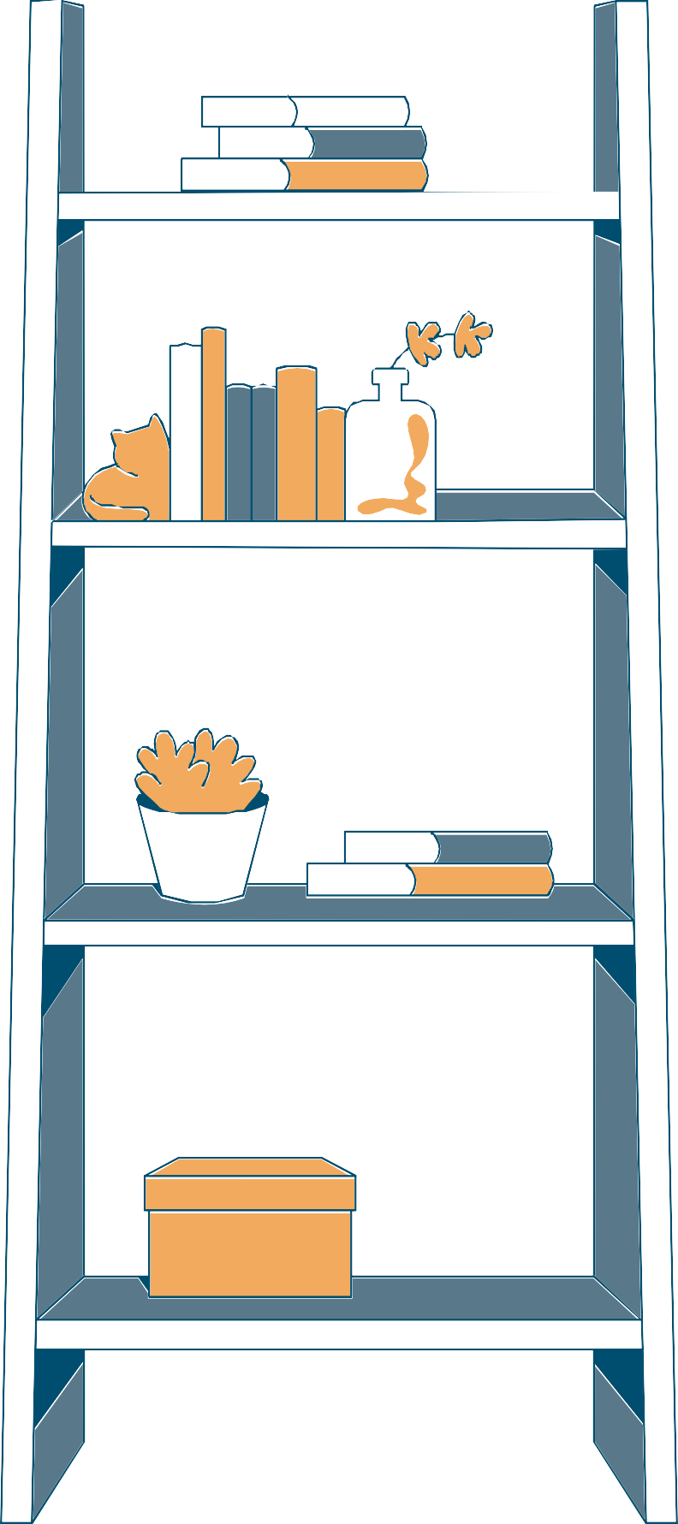
Method
Using a literature review method to examine the key role of teachers in creating a prosperous school environment for high school and vocational high school students, as well as readiness for marriage through online group guidance.
The literature review process is carried out with the following steps, namely by identifying relevant literature sources through academic databases such as Google Scholar, PubMed and several others.
1
2

Slide 6
Result & Discussion
Result :
The Role of Teachers in Student Well-Being (Hattie, 2009)
Marital Readiness in Adolescents (Carroll et al.,2009)
Effectiveness of Online Group Guidance (Paulk et al., 2020)

Slide 7
Discussion
Teachers who are able to build positive relationships with students can help increase student motivation and engagement, which in turn can improve their overall well-being.
Research shows that many adolescents marry young without adequate preparation, which can result in various problems in their married life.
Online guidance and counseling can be easily accessed by students, and can be tailored to their individual needs.
.

Slide 8
Conclusion
Positive relationships between teachers and students can increase students' motivation and engagement in school.
Marriage readiness in adolescents requires the development of interpersonal competencies, long-term commitment, and the capacity to care for others. Proper guidance is essential in preparing adolescents for marriage.
Online group guidance provides greater flexibility and access, especially for students who have limited access to face-to-face guidance.

Slide 9
Recommendation
Improving Teacher Competence:
Schools and educational institutions should conduct training for teachers to improve their competence in providing emotional and social support to students.
Implementing Online Group Guidance Programs:
Schools need to develop and implement online group guidance programs that focus on marriage readiness. These programs should be designed to accommodate individual student needs and provide timely support.
Increasing Student Access and Engagement:
It is important to ensure that all students have adequate access to the technology needed to participate in online tutoring. In addition, teachers should strive to increase student engagement in these tutoring programs through an inclusive and interactive approach.
Collaboration with Parents and the Community:
Schools should collaborate with parents and the community to support the holistic well-being of students. Parental involvement in tutoring programs can increase the effectiveness of the support provided to students.
By implementing these suggestions, we hoped more prosperous school environment can be created and students who are better prepared to face life's challenges, including marriage.

Slide 10
Thank
You

